Slide 1


Group #1
CIST 3222 – Database Systems STOCKTON
DINING DB
04/26/2025
Cachary Tolentino, Tyler Mong, Melvin Vazquez, Dylan Calixtro
Notes:
Cachary

Slide 2
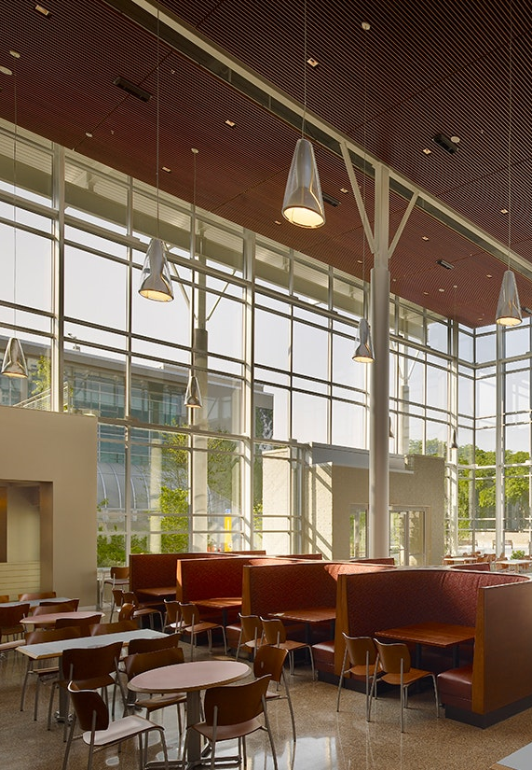

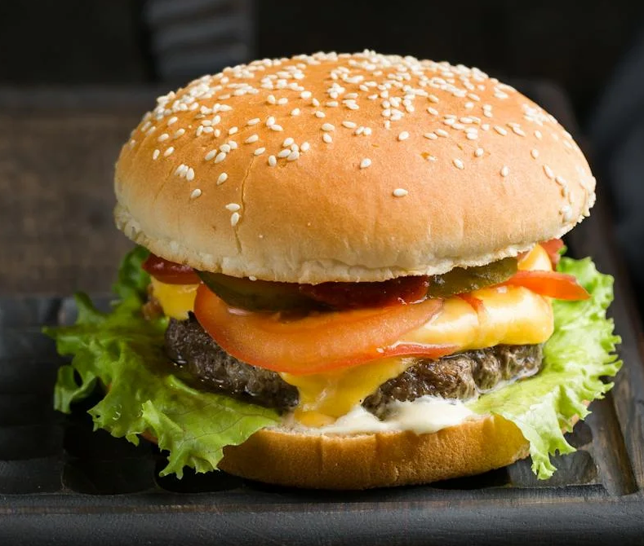
BUSINESS OVERVIEW
Name of Business:
Purpose of Business:
Stockton Dining
Provide service to faculty, students, and guests visiting Stockton University
Provide delicious and affordable meals daily
Provide a variety filled food menu
Key Business Activities:
Operate 7 days a week providing food to everyone within the Stockton Institution area
Ensure each day consists of a rotating menu that is also fair and balanced
Ensure that the meals are priced at an affordable price that everyone is able to afford and enjoy the meals
Notes:
Cachary

Slide 3
CURRENT PROBLEMS
Lack of interactive/fluent database
Lack of customers
Old fashion inventory tracking
BUSINESS
OPPORTUNITIES
Up to date inventory
Improved management
Improved Menus
Notes:
Cachary

Slide 4
BUSINESS
OBJECTIVES
Maximizing inventory tracking
Clear and concise menu
Identify consumer patterns → improved flow of traffic
Ensure a more organized and efficient system is in place to keep track of their stock
Collect information on the consumers that buy from them
Ensures customers are properly informed of what they are eating and any allergens the food contains
This database will help keep track of important information such as:
Keeping track of inventory
Meeting consumer needs
BUSINESS
CASE
Notes:
Cachary

Slide 5
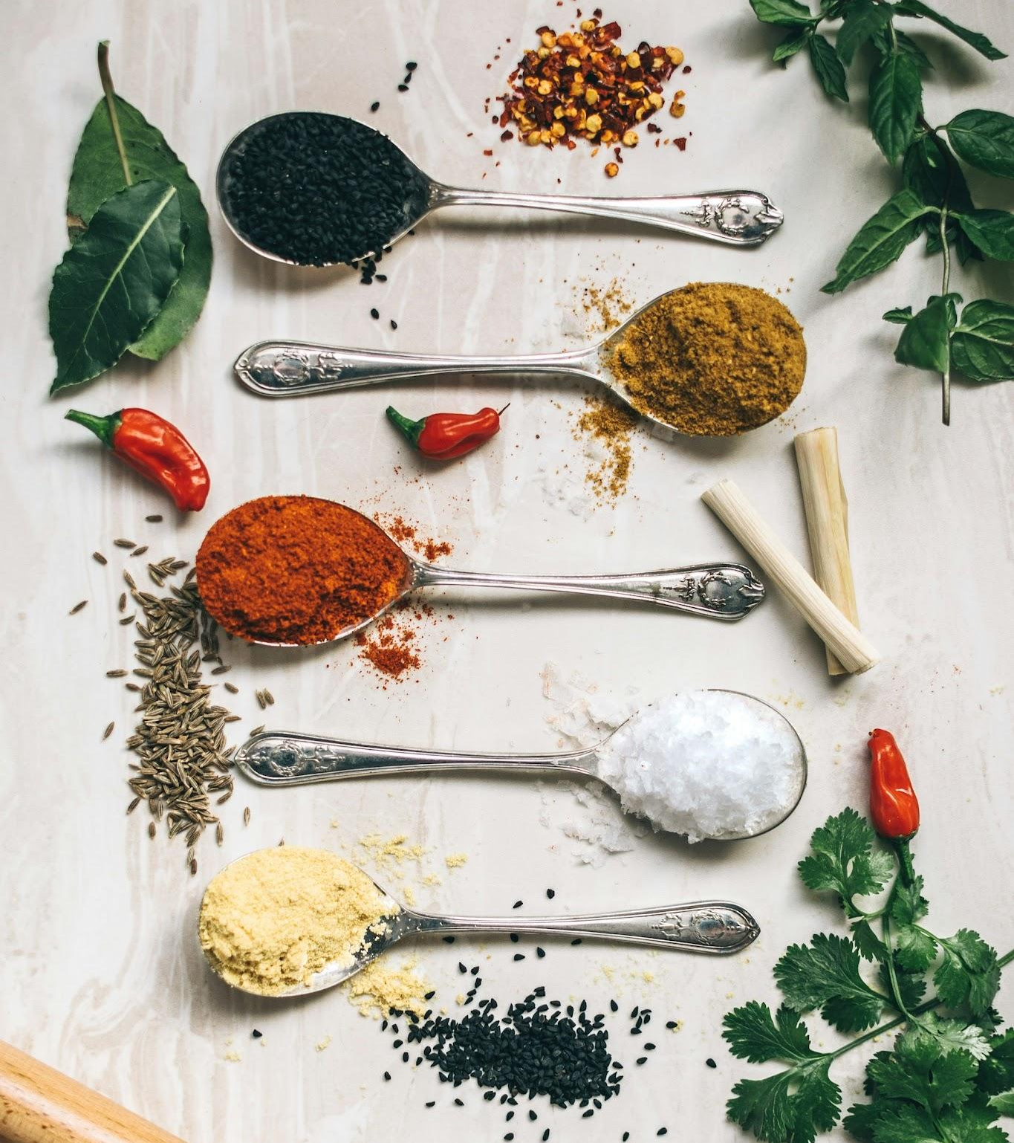
DATA REQUIRED
Menu Item Name
Menu ID
Menu Category
Ingredient Name
Ingredient Quantity
Menu Item Allergens
Transaction Time
Notes:
Melvin

Slide 6
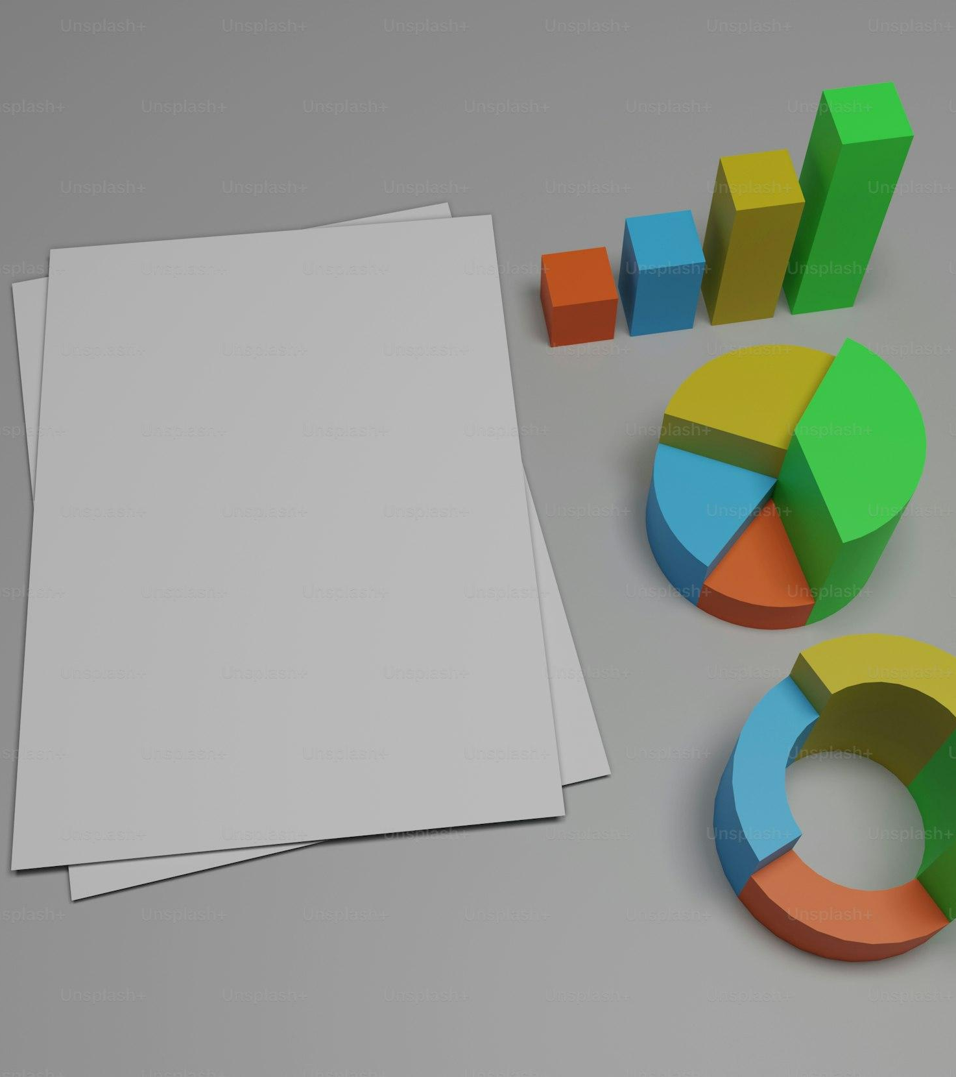
INFORMATION GENERATED
Most popular meals from
Menu Item name, Menu Category, and Ingredient Quantity
Ingredient Usage from
Menu item name and Ingredient Quantity
Busy hours from
Transaction time
Gluten Trends from
Menu item name and Ingredient Quantity
Notes:
Melvin

Slide 7
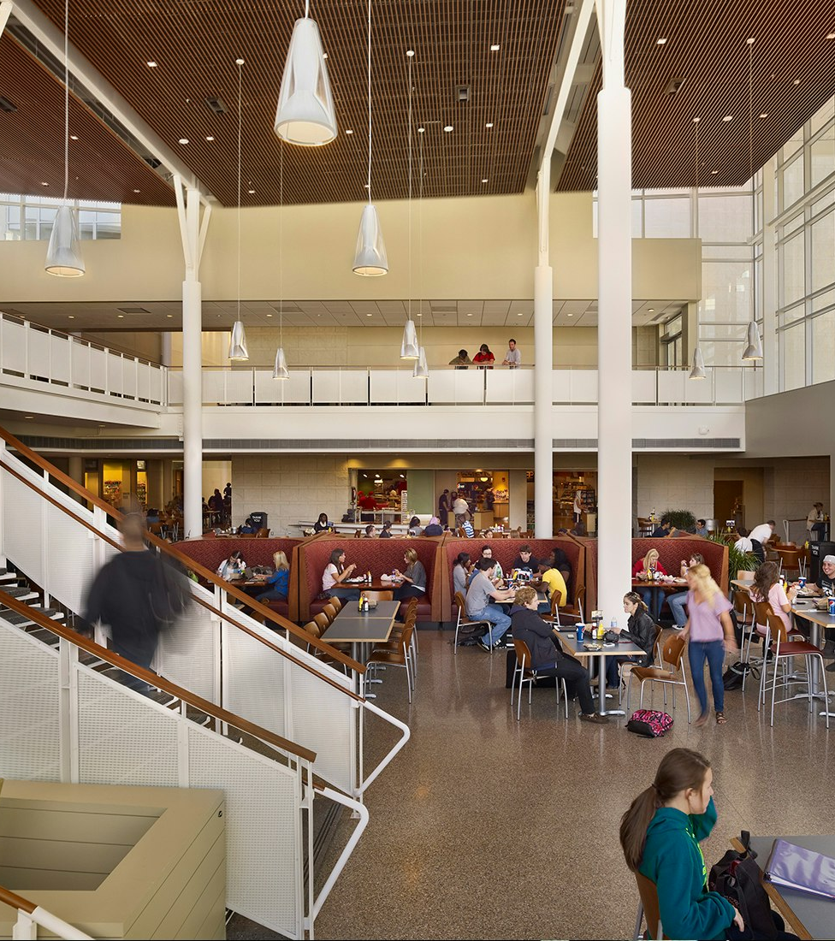
DATA
IMPORTANCE
By learning about the popular meals, we can optimize menus to make more profit and make consumers happy
By tracking ingredients we can avoid shortages and avoid buying ingredients that are not needed
By predicting busy hours we can prepare appropriate staff to work those times
Through tracking ingredients we can ensure food safety by flagging allergens
Notes:
Melvin

Slide 8

ENTITIES
EMPLOYEE: (EmployeeID, FirstName, LastName, Email, ZNumber, DOB, Role, IsActive)
MENU_ITEM: (MenuItemID, MenuName, Category, Price)
INGREDIENT: (IngredientID, IngredientName, Quantity, Unit, MinimumStockLevel)
INGREDIENT_USE: (MenuItemID, IngredientID, Quantity, Instruction)
ALLERGENS: (AllergensID, AllergenDescription)
CUSTOMER: (CustomerID, FirstName, LastName, Email, ZNumber)
TRANSACTION_ITEM: (TransactionID, MenuItemID, Quantity, UnitPrice, ExtendedPrice)
TRANSACTION: (TransactionID, CustomerID, EmployeeID, TransactionTime, SubTotal, Tax, Total)
Notes:
Dylan

Slide 9
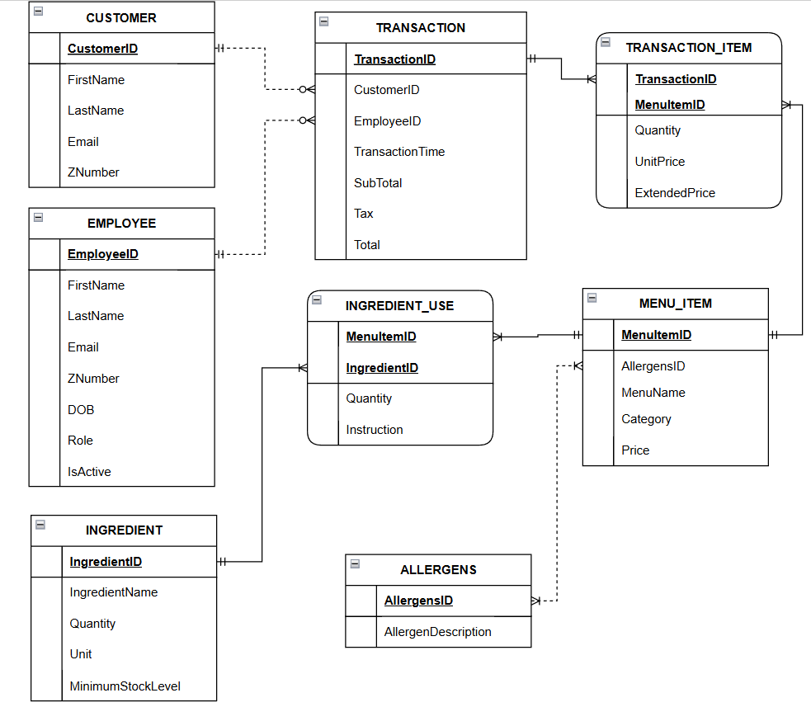
CONCEPTUAL DATA MODEL
Notes:
Dylan

Slide 10
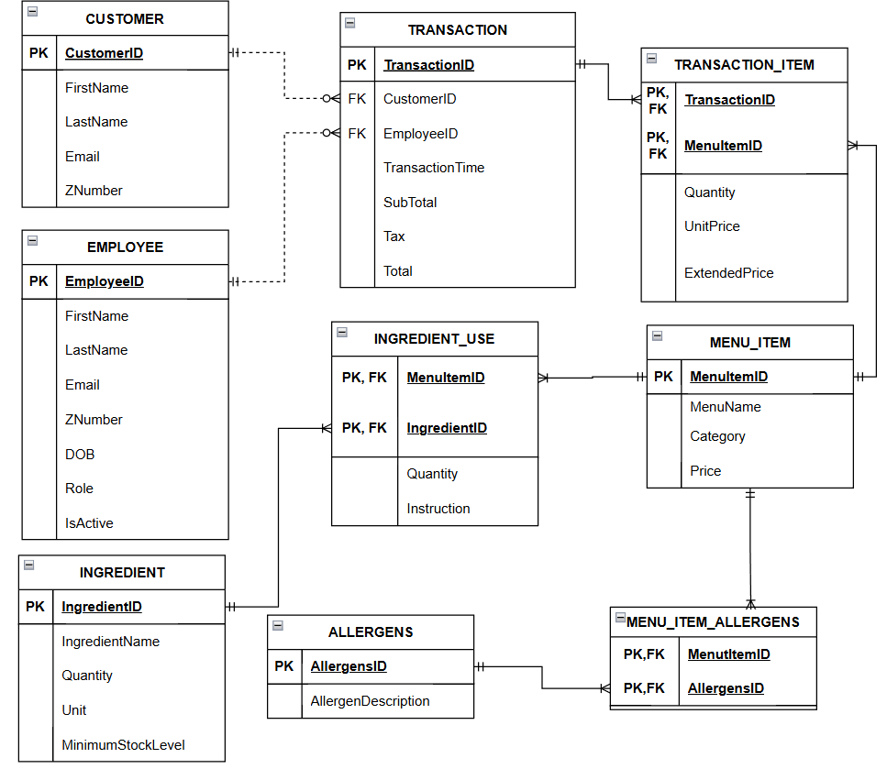
DATABASE DESIGN MODEL
Added Tables:
MENU_ITEM_ALLERGENS
Notes:
Dylan

Slide 11
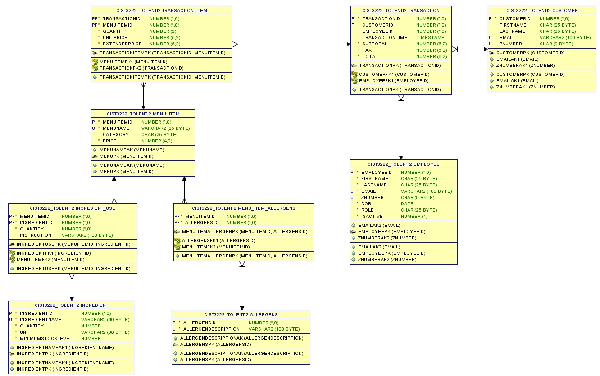
DATABASE IMPLEMENTATION
Notes:
Tyler
Maximum / minimum cardinalities of relationships between entities EMPLOYEE → TRANSACTION
1:M >> An employee can be responsible for multiple transactions, while each transaction belongs to one employee.
M:O >> An employee can have 0 to many transactions, while all transactions must be associated with an employee.
MENU_ITEM → INGREDIENT_USE
1:M >> An item can use many ingredients and each usage of that ingredient belongs to a single item.
M:M >> All items must use an ingredient and all ingredients must be in use.
INGREDIENT → INGREDIENT_USE
1:M >> An ingredient can have many uses, but any given use can only belong to one ingredient.
M:O >> Each ingredient can have 0 to many uses, but all usage must be related to one ingredient.
MENU_ITEM → ALLERGENS
M:M >> An item can have many allergens, and an allergen can be in many different items.
O:O >> An item can have 0 to many allergens, and an allergen can be in 0 to many items
CUSTOMER → TRANSACTION
1:M >> A single customer can have multiple transactions, but each transaction can only belong to one customer
M:O >> A customer can have 0 to many transactions, while all transactions must belong to a customer
TRANSACTION → TRANSACTION_ITEM
1:M >> A single transaction can have many items in it, but all items in that transaction only belong to that single transaction
M:M >> All transactions require items and all transactions items require a transaction to be a part of
MENU_ITEM → TRANSACTION_ITEM
1:M >> A single menu item can appear in many transaction items, but each transaction item can only refer to one menu item
M:O >> A menu item can have 0 to many transaction items, but every transaction item must be linked to exactly one menu item
Strong / weak entities
All tables (EMPLOYEE, CUSTOMER, MENU_ITEM, ALLERGENS, INGREDIENT, TRANSACTION) are strong entities (as they have a PK that’s unique by itself),
except TRANSACTION_ITEM and INGREDIENT_USE, as they depend on other entities to exist.
ID dependent / non-ID dependent entities
All tables (EMPLOYEE, CUSTOMER, MENU_ITEM, ALLERGENS, INGREDIENT, TRANSACTION) are non-ID dependent entities (as they have a PK that’s independent of other entities),
except TRANSACTION_ITEM and INGREDIENT_USE, as they depend on another entities PK to form their own.
Identifying / non-identifying relationships
All tables have are non-identifying relationships (child PK is independent, just has a FK pointing to parent entity)
except TRANSACTION_ITEM and INGREDIENT_USE, as they depend on TRANSACTION and MENU_ITEM, respectively, to form a composite key.

Slide 12
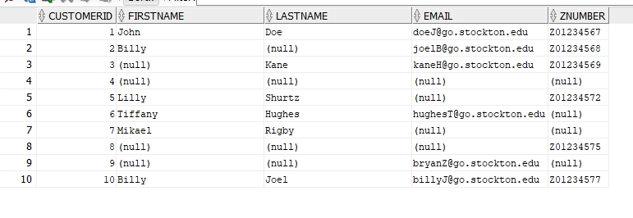
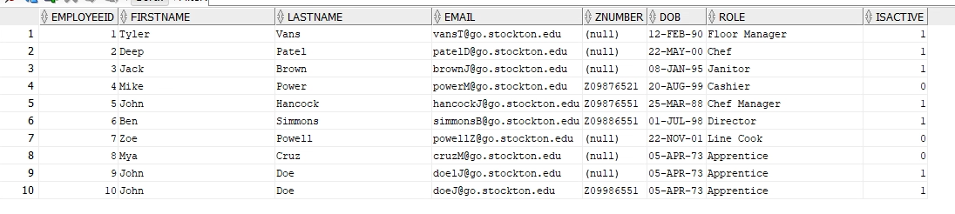
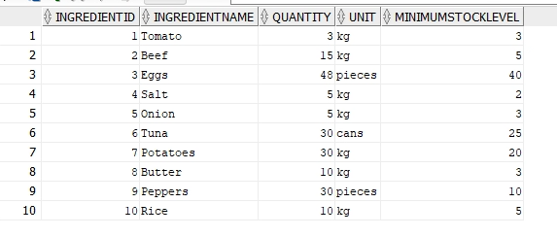
DATABASE IMPLEMENTATION
CUSTOMER Table:
EMPLOYEE Table:
INGREDIENT Table:
Notes:
Tyler
N/A

Slide 13
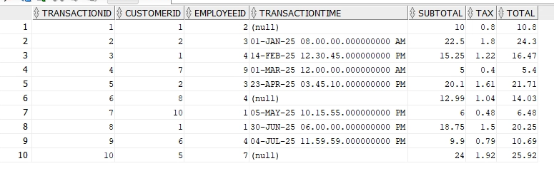
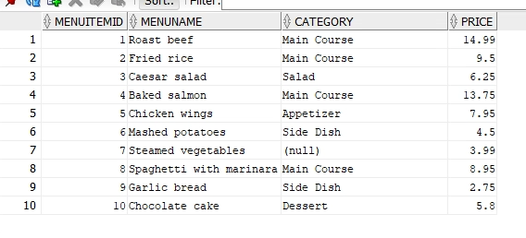
DATABASE IMPLEMENTATION
TRANSACTION Table:
MENU_ITEM Table:
Notes:
Tyler
N/A

Slide 14
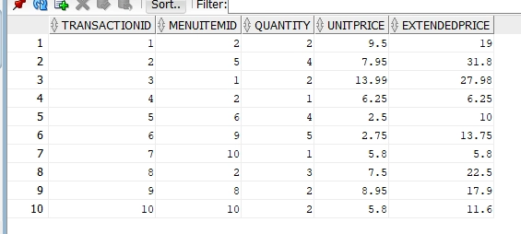
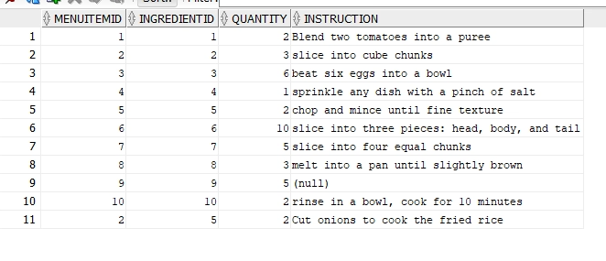
DATABASE IMPLEMENTATION
TRANSACTION_ITEM Table:
INGREDIENT_USE Table:
Notes:
Tyler
N/A

Slide 15
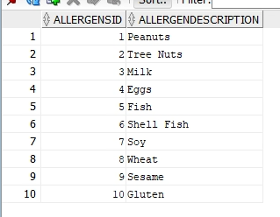
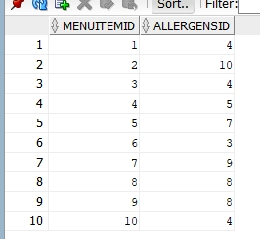
DATABASE IMPLEMENTATION
ALLERGENS Table:
MENU_ITEM_ALLERGENS
Table:
Notes:
Tyler
N/A

Slide 16



